Slide 2
The Orvis Company – monitoring more effectively and making builds more repeatable.

Slide 3

Marten vanZwietering
Web Development Manager

Slide 4
Goals of this talk
Talk about ground rules
Rules of Engagement
How do we communicate to improve what is being shown, and make something that can be a learning experience for everyone.
Data Layers
What is a data layer
How can I put it to good use to improve the agility of marketing programs at a company
Sample OP Maturity Model
The First Taste is Free
The Orvis Company’s adoption of the ObservePoint platform
Build Automation
Tying ObservePoint into Builds
How ObservePoint can help improve build accuracy by including it into the build pipelines. There will be a demo to help understand how this can work for you.
Demo!
Time to check Adobe Summit Network Availability
Walk through a live demo to show the Build Automation Journey at work

Slide 5
Rules of Engagement
- Don’t take notes unless it helps you
All notes and the demo from this presentation will be made available ( the demo is at https://github.com/TyphoidMarty/TyphoidMarty.github.io )
- Ask questions
We all learn when we are brave enough to ask questions.
- Add to the bare implementation
Use your strengths to help support this community. Make cool rules or integrations available.

Slide 6
Data Layers
From the W3C document (https://www.w3.org/2013/12/ceddl-201312.pdf ):
A data layer describes a method for surfacing customer experience digital data on a web or other digital resource as a JavaScript Object which can be used for communicating this data to digital analytics and reporting servers.
As such, a data layer should only contain publicly accessible information. It should not surface PII data about customers, and it should not give competitors inside information about your own company (profit margins on a product for instance).
Why is it useful? As a place to store data and easily turn it around to use in analytics, third party tags and for personalization. This data can be persisted in the session by a tag management solution and action against anywhere in the customer journey.

Slide 7
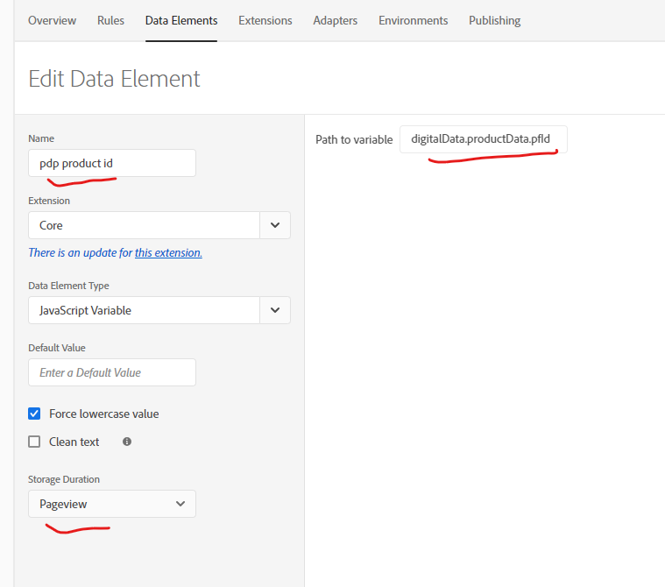
Data Layers
We can see in the image to the left, this Adobe Launch data element is using a data layer variable (the “Path to variable”), and persisting it in this case only for a Pageview (though we could also choose to persist for Session).
We can now drop this data element directly into Adobe Analytics, Adobe Target, or a third party tag.

Slide 8
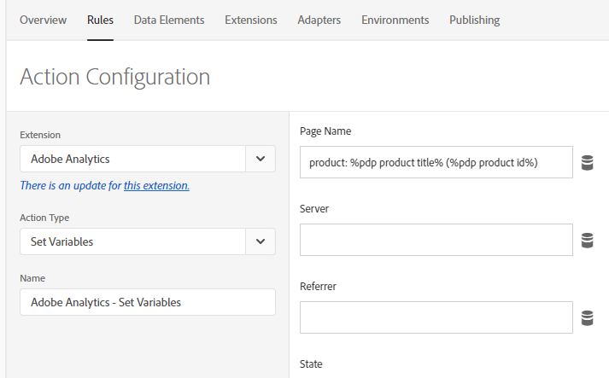
Data Layers
Here is a simple example of how this is working for Adobe Analytics. The Page Name variable is comprised of a static string (“product:”) a product title variable, and the pdp product id we saw above in parens.
Without code changes, we could change this to anything we have dropped into the data layer, and as it is output directly from site code into this layer, there are no efforts to scrape the page to gather data.

Slide 9
Sample OP Maturity Model
(The first taste is free)
Adobe Experience Cloud Auditor (a free lite version of the ObservePoint suite – see more at https://marketing.adobe.com/resources/help/en_US/auditor/ ) is such a great introduction to this space.
As we learn the benefits of automation for tags which can prove so difficult to ensure are firing properly, it becomes very easy to see the benefit of the full suite and the partnership with ObservePoint. Which moves us forward in the funnel towards better automation.

Slide 10
Sample OP Maturity Model
Tagging Audit Sophistication
Free or unsophistated audits
More sophisticated and regular auditing
Customer journeys through key workflows
Automated journeys to ensure build integrity
A good sophistication progression might then look like the above flow then, with initial audits to ensure tag presence giving way to auditing for specific variables. Later, journeys can be added to regularly check for site responsiveness to typical user journeys and finally we can automate this into our build pipeline to make sure that new code is not breaking existing functionality.

Slide 11
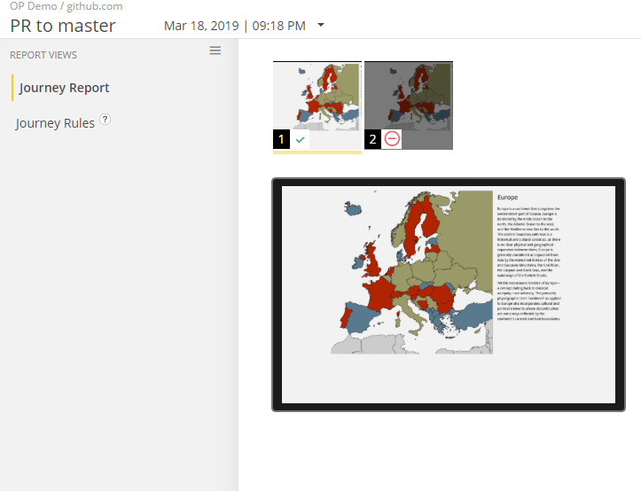
Build Automation
Create a Journey
Put into place a Journey to test out functionality. In a real world scenario this would involve a combination of tagging rules to ensure that key site flows have not been broken.
For the purposes of the demo, we are just ensuring the link is still available and clickable to go to the next page.

Slide 12
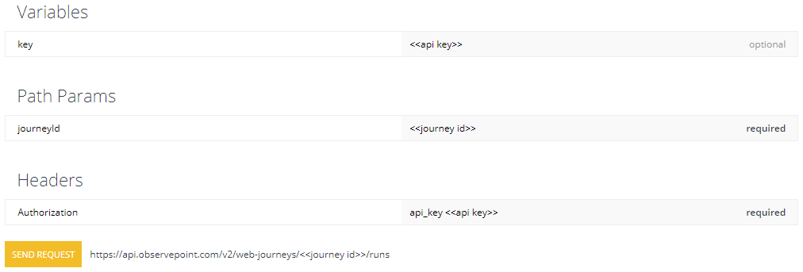
Build Automation
Generate Code
Next go to the API Documentation to generate the code to use in the pipeline.
https://docs.api.observepoint.com/v2/web-journeys/kBx7Qrs2wM85FR5MN
Fill out the journey id from the journey made in the previous step (the ID is in the url) and your company API key.

Slide 13
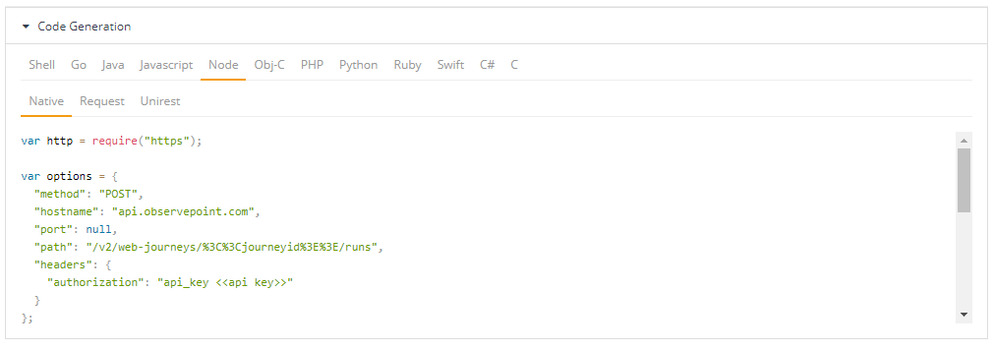
Build Automation
Lastly for this step, scroll down to the code generation area below.
There are a ton of choices, but as I am using BitBucket, the Node integration works great for me.
We can test the code by clicking Send Request, above.

Slide 14
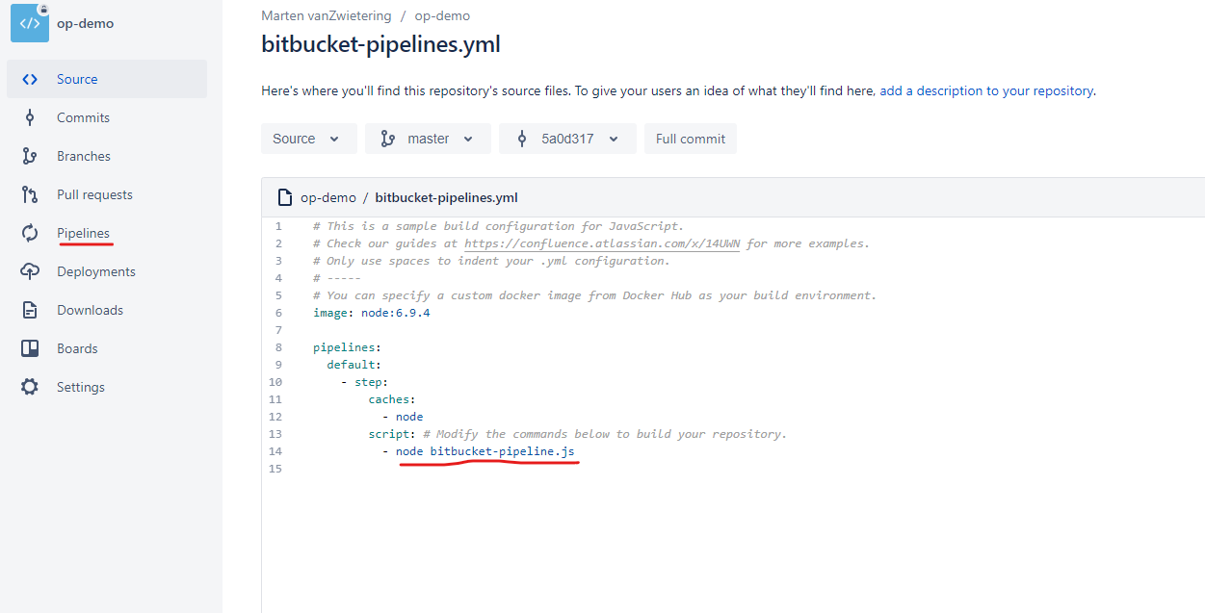
Build Automation
Add code to the pipeline
Last thing is to add this code to the pipeline. Easiest way for me was to drop it into a JS file and tie that into the pipeline like so:

Slide 15
It’s Demo Day
(Channeling Chip and Joanna Gaines)
Live Demos are the best!

Slide 16
Build Automation
Next steps might include JIRA integration - to make tickets based upon Journey failures, which ObservePoint supports but is sadly outside the realm of this presentation.
Feel free to leave comments and how-tos for that or anything else related on the sample Github code I mentioned earlier:
https://github.com/TyphoidMarty/TyphoidMarty.github.io

Slide 17
With Thanks!
The ObservePoint team have been incredibly supportive in my journey through this space, special thanks go to:
- Chris O’Neill – who showed me how to do all these cool integrations
- Lacee Jones – the best customer consultant (and it’s official)
- Kara Frazier – who gave me the opportunity to make this talk!

